Slide 1
Getting to Know United Way

Slide 2
Agenda
Who we are
What we do
Why we do what we do
How you can help

Slide 3
Who we are
Established in 1941
Bring together businesses, government, nonprofits and community leaders to fight for health, education and financial stability
Serve communities across Kankakee and Iroquois counties

Slide 4
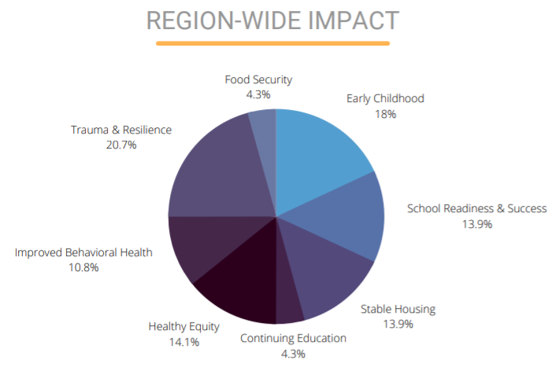
What we do
Community Investment
Nearly $369,170 granted to 20 local agencies in FY 2021-2022
Funded programs fight for the heath, education, and financial stability of families in Kankakee & Iroquois Counties
We fight for change in our community by funding effective, data-driven programs, and do not provide direct assistance to individuals

Slide 5
What we do
Success By 6
Early childhood community collaborative
Family and parent engagement
Behavioral and mental health services
Greater awareness of resources for parents, caregivers and early childhood providers
Local Activities
Early Childhood data collection
Introduction of a Success By 6 Steering Committee

Slide 6
What we do
Women United
Brings women together to further advance the mission of United Way to improve the lives of women and girls
Fundraising events
Volunteer service projects
Social networking opportunities
Local Activities
EmpowHER Hour Networking Events
Quarterly Kindness Projects
Women United Annual Breakfast

Slide 7
Impact Areas
Why we do what we do

Slide 8
Education
Helping individuals achieve their potential through education
Our Goals
Children’s health, social, emotional, language and literacy skills are supported to lay a strong foundation for a successful life.
Students successfully transition through school gaining the knowledge, skills and abilities they need for success.
Students graduate high school on time prepared for post-secondary education and/or training, work and life.
Why?
Nearly 70% of local children do not read proficiently for their grade level
Three in five kindergarten students are not entering school ready to achieve

Slide 9
Financial Stability
Helping households become financially stable and independent
Our Goals
Individuals pursue educational opportunities to increase financial stability.
Individuals have the knowledge, skills and supports to make choices that increase their financial stability and advance their economic mobility.
Safe, good quality housing units are available at an affordable cost.
Why?
One-third of households in Kankakee and Iroquois counties had no emergency savings before the pandemic.
Over 19,000 households in Kankakee and Iroquois counties cannot afford the most basic household budget.

Slide 10
Health
Helping support safe, stable environments and nurturing relationships
Our Goals
All households have easy access to ample, affordable high-quality healthcare.
Babies are born at a healthy birthweight and grow in healthy environments.
Households are free from Adverse Childhood Experiences (ACEs), violence, and physical hazards.
Households will demonstrate improved behavioral health by reporting better mental health and a reduction in substance abuse.
All households will have access to healthy, nutritious food.
Why?
One in three local 10th graders reported feeling depressed before the pandemic.
One in ten families in Kankakee and Iroquois counties are food insecure.

Slide 11
Ways your organization can partner
United Way works together with partners to create initiatives that engage employees in deeper ways while improving the communities in which they live and serve.
Corporate Sponsorships
Workplace Giving
Women United/Affinity Groups
Volunteer Opportunities

Slide 12
Starting today, give for tomorrow

Slide 13
Thank You!
Kerstin Rust
Executive Director
info@myunitedway.org
200 East Court Street, Suite 500
Kankakee, IL 60901

